Slide 1
Module 4
Scenarios & Case Studies

Slide 2
Participation Instructions
Modules 1, 2 and 3 were delivered via a recorded presentation. However, Module 4 is different as it requires delegate participation and answering questions via web links for practice.
There are some animations in this module that are used to explain scoring. Please enter PowerPoint’s present mode by clicking the shortcut button in the top bar, as can be seen in the left circle, or by clicking “Slide Show” and ”Start From Beginning”. Further instructions on how to access presenter mode can be found on the Microsoft Website. Once you are in Present Mode, please click through this module.
In presenter mode, you can click hyperlinks by holding 'Ctrl' and clicking. This method is easier if you have two screens open. If you don't have two screens, you can exit presenter mode by pressing the "Esc" button. Alternatively, you can use the PowerPoint slide numbers located at the bottom right of each slide and match them with the downloadable hyperlink table available on the Regulators Companion website.

Slide 3
Case Studies
The Food Law Code of Practice
can be found on the FSA’s food.gov website
As this is not a live session we have modified the approach for this module.
The scenarios are purposefully vague to generate discussion in the training session.

Slide 4
Case Study 1 – Local Takeaway
Click on the link and score the business based on the scenario.
Then once complete move onto the next slide.
The scenario for the Case Study is at the top of the form, please jot down your results on a piece of paper as this will allow you to compare with the guide results.
Once all risk scores have been selected press the submit button.

Slide 5
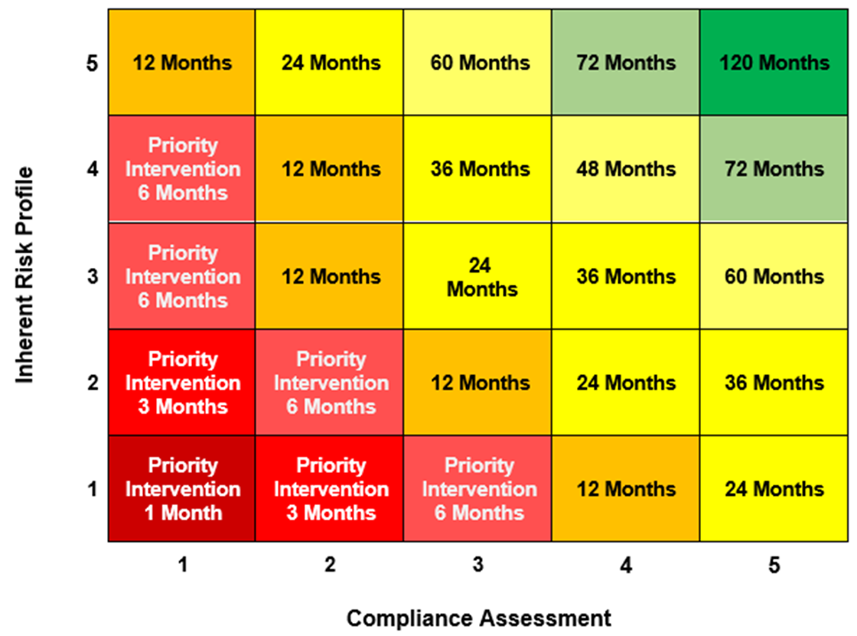
Decision Matrix - Case Study 1
Inherent Risk | Score
Scale & Supply | 4
Ease of Compliance | 3
Complexity | 3
Responsible for Information | 4
Potential for Harm | 3
Average | 3 (3.4)
Compliance Assessment | Score
Management Systems | 1
Allergen Information | 1
Current Compliance | 1
Confidence in Management | 1
Average | 1 (1)
Due to the rule of one, their Compliance Assessment can only be a maximum of 1.
Notes:
If we risk assess such a business under the proposed new model it is given an Inherent Risk of 3 and, due to the rule of one, their Compliance Assessment is given a score of 1.
Plotting these scores on the decision matrix.
The matrix produces a Priority Intervention of 6 months
This must be an inspection, partial inspection or audit.
A revisit can be carried out depending on the nature of non compliances found.
Given the “near misses” then revisits should be carried out until at least the premises are “broadly compliant”

Slide 6
CASE STUDIES
We have a few more case studies for you to complete, following the same format as before

Slide 7
Case Study 2
Click on the link and score the business based on the scenario.
Then once complete move onto the next slide.
The Scenario is at the top of the form, please jot down your results on a piece of paper as this will allow you to compare with the guide results
Once all risk scores have been selected press the submit button.

Slide 8
Case Study 2
Inherent Risk | Score
Scale & Supply | 4
Ease of Compliance | 3
Complexity | 4
Responsible for Information | 3
Potential for Harm | 3
Average | 3 (3.4)
Compliance Assessment | Score
Management Systems | 4
Allergen Information | 5
Current Compliance | 5
Confidence in Management | 4
Average | 5 (4.5)

Slide 9
Case Study 3
Click on the link and score the business based on the scenario.
Then once complete move onto the next slide.
The Scenario is at the top of the form, please jot down your results on a piece of paper as this will allow you to compare with the guide results
Once all risk scores have been selected press the submit button.

Slide 10
Case Study 3
Inherent Risk | Score
Scale & Supply | 4
Ease of Compliance | 2
Complexity | 4
Responsible for Information | 2
Potential for Harm | 2
Average | 3 (2.8)
Compliance Assessment | Score
Management Systems | 1
Allergen Information | 1
Current Compliance | 1
Confidence in Management | 2
Average | 1 (1.25)
Again, due to the rule of one, their Compliance Assessment is given a score of 1.

Slide 11
Case Study 4
Click on the link and score the business based on the scenario.
Then once complete move onto the next slide.
The Scenario is at the top of the form, feel free to jot down your results on a piece of paper.
Once all risk scores have been selected press the submit button.

Slide 12
Case Study 4
Inherent Risk | Score
Scale & Supply | 4
Ease of Compliance | 3
Complexity | 5
Responsible for Information | 3
Potential for Harm | 3
Average | 4 (3.6)
Compliance Assessment | Score
Management Systems | 4
Allergen Information | 5
Current Compliance | 5
Confidence in Management | 5
Average | 5 (4.75)

Slide 13
Case Study 5
Click on the link and score the business based on the scenario.
Then once complete move onto the next slide.
please jot down your results on a piece of paper as this will allow you to compare with the guide results
Once all risk scores have been selected press the submit button.

Slide 14
Case Study 5
Inherent Risk | Score
Scale & Supply | 4
Ease of Compliance | 3
Complexity | 3
Responsible for Information | 3
Potential for Harm | 3
Average | 3 (3.2)
Compliance Assessment | Score
Management Systems | 1
Allergen Information | 1
Current Compliance | 1
Confidence in Management | 2
Average | 1 (1.25)

Slide 15
Case Study 6
Click on the link and score the business based on the scenario.
Then once complete move onto the next slide.
please jot down your results on a piece of paper as this will allow you to compare with the guide results
Once all risk scores have been selected press the submit button.

Slide 16
Case Study 6
Inherent Risk | Score
Scale & Supply | 3
Ease of Compliance | 5
Complexity | 5
Responsible for Information | 5
Potential for Harm | 5
Average | 5 (4.6)
Compliance Assessment | Score
Management Systems | 5
Allergen Information | 5
Current Compliance | 5
Confidence in Management | 5
Average | 5 (5)
Notes:
If we risk assess such a business under the proposed new model it is given an Inherent Risk of 2 and, due to the high level of compliance and the procedures they have in place, their Compliance Assessment is given a score of 5. [Can add detail by going through each of the 9 risk factors].
Plotting these scores on the decision matrix [Click][Click], gives us an intervention frequency of [Click] 36 months for the next official control.

Slide 17
Summary
The FSDM facilitates flexibility in delivery and the use of intelligence to:
Target resources where they will be most effective
Allow for use of new technologies in Official Controls if they are appropriate.
It will, by use of the LAICT allow intelligence to be used across the food enforcement environment
This will result in lower levels of non-compliant and potentially dangerous foods in the marketplace
We hope you have found this webinar useful- any Qs- we hope to expand on these & develop consistency exercises in the future

Slide 18
Thank you for participating!
This is the end of module 4 and the end of the training.
Any questions please email
FSDMEnquiries@food.gov.uk

